Slide 1

Unlocking The Secrets of Successful Game Design
Cheng Yin

Slide 2
Self-Introduction
Data Analyst – 6 years at Random company
Bachelor degree in Mathematics
Certified in SQL, Python, Tableau
Cheng Yin

Slide 3
The Data
Sales data for video games in different regions from 1980 to 2020.
Game platform data from 1980 to 2020.
Game rating data from 1980 to 2020.
More details:
https://www.kaggle.com/datasets/rush4ratio/video-game-sales-with-ratings

Slide 4
Project Objective
which game genres to develop
Help Game designers in gaining valuable insights to determine which platform to choose.
Which rating system to concentrate on

Slide 5
Guideline
Sales Across regions
Genre Performing
Top 3 modern game
Rating system
Conclusion/Question
Platform Lifetime

Slide 6
Genre Sales By Region
Notes:
Turn to Tableau

Slide 7
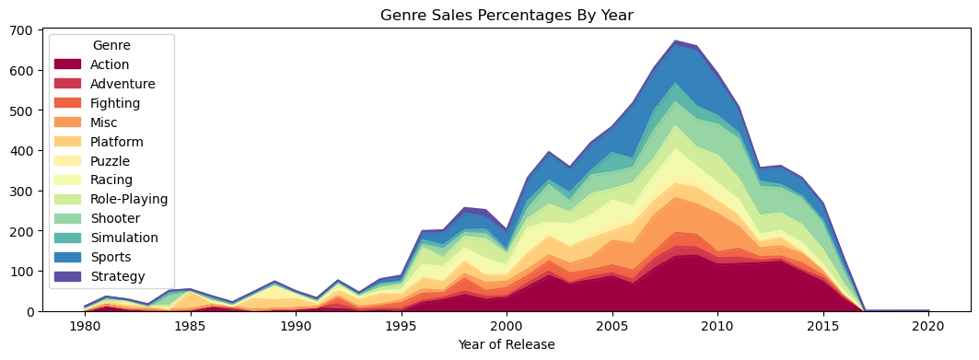
The Percentage of Sales of Each Genre Over the Years
Despite having the lowest percentage, it’s noteworthy that action contributes the most global sales.
Notes:
This is Area plot
Genre Sales Percentages by year formula: it divides the global sales for each genre in a particular year by the total global sales for that year, and then multiplies the result by 100.

Slide 8
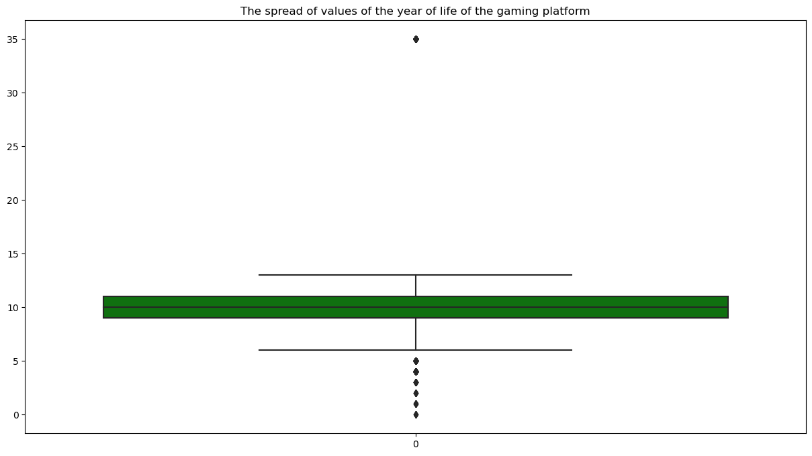
Box plot of Platform Lifetime
Median platform lifetime is around 10 years.
An outlier platform lifetime is 35 years.

Slide 9
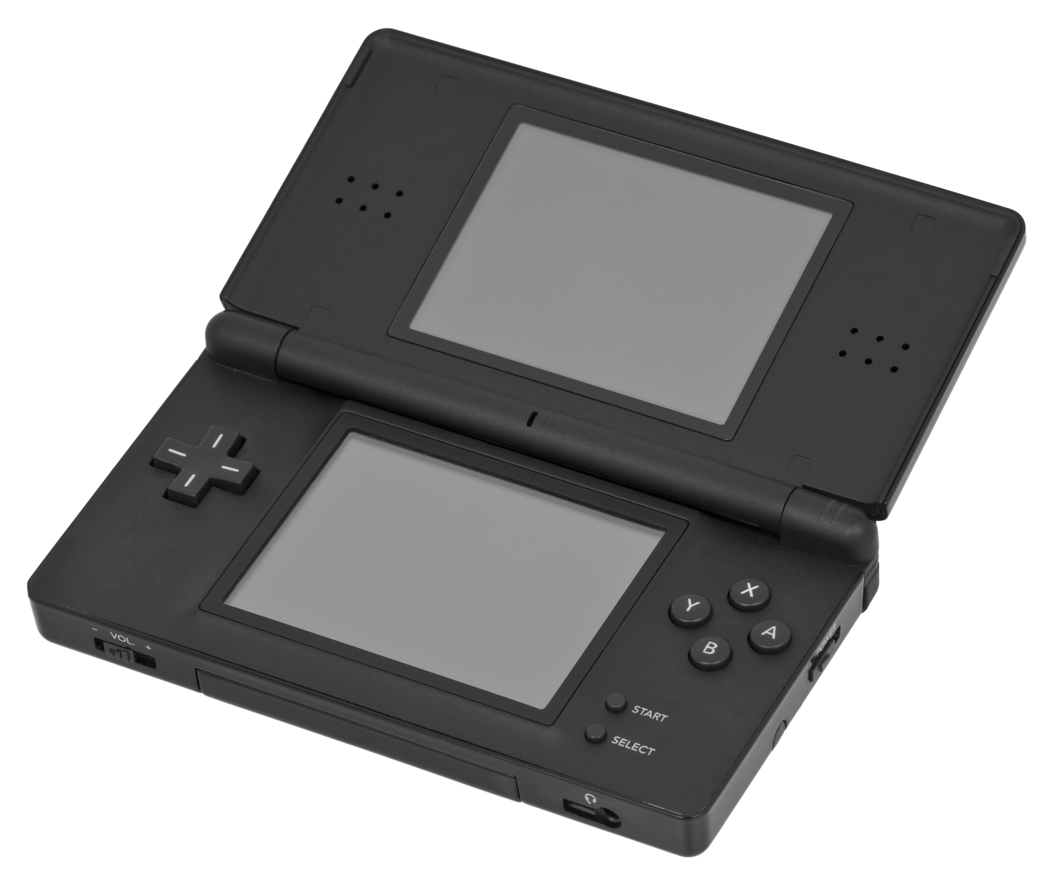
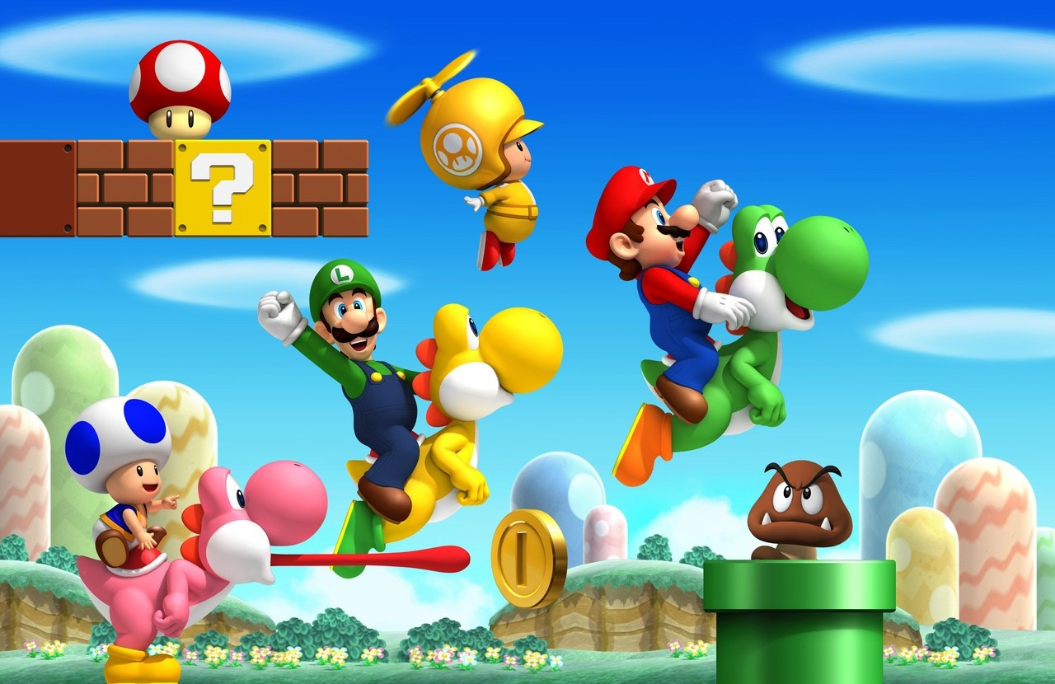
Platform | lifetime
DS | 35
The DS Platform game has remarkable 35-year lifetime.

Slide 10
Top 10 Platform Lifetime
Platform | Lifetime
GB | 13.0
PS2 | 11.0
X360 | 11.0
NES | 11.0
PSP | 11.0
PS3 | 10.0
Wii | 10.0
DC | 10.0
SNES | 9.0
2600 | 9.0
Long-lived platforms include GB, Xbox360, PS2 and PS3, Wii.

Slide 11
Rating system
#"EC" ("Early childhood") - "For Young Children"
#“E” (“Everyone”) - “For everyone”
#“E10 +” (“Everyone 10 and older”) - “For everyone 10 and older”
#"T" ("Teen") - "Teens": For people aged 13 and over.
#"M" ("Mature") - "For Adults"
#"AO" ("Adults Only 18 +") - "Adults Only"
#"RP" ("Rating Pending") - "Rating Pending"

Slide 12
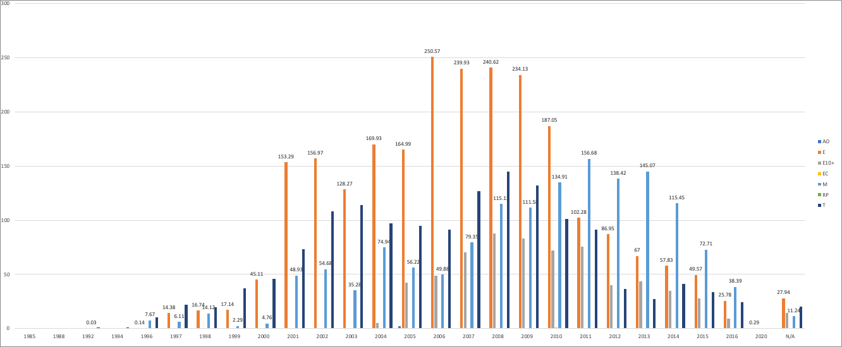
Rating Trend
Notes:
Between 2000 and 2010, the majority of games were created with ‘E' (Everyone) rating. However, over time, there has been a noticeable shift in the trend towards designing games with ‘M' (Mature) rating. So, the game designers may consider design games for adults to make success.
Let’s see the evidence for the rating trend

Slide 13


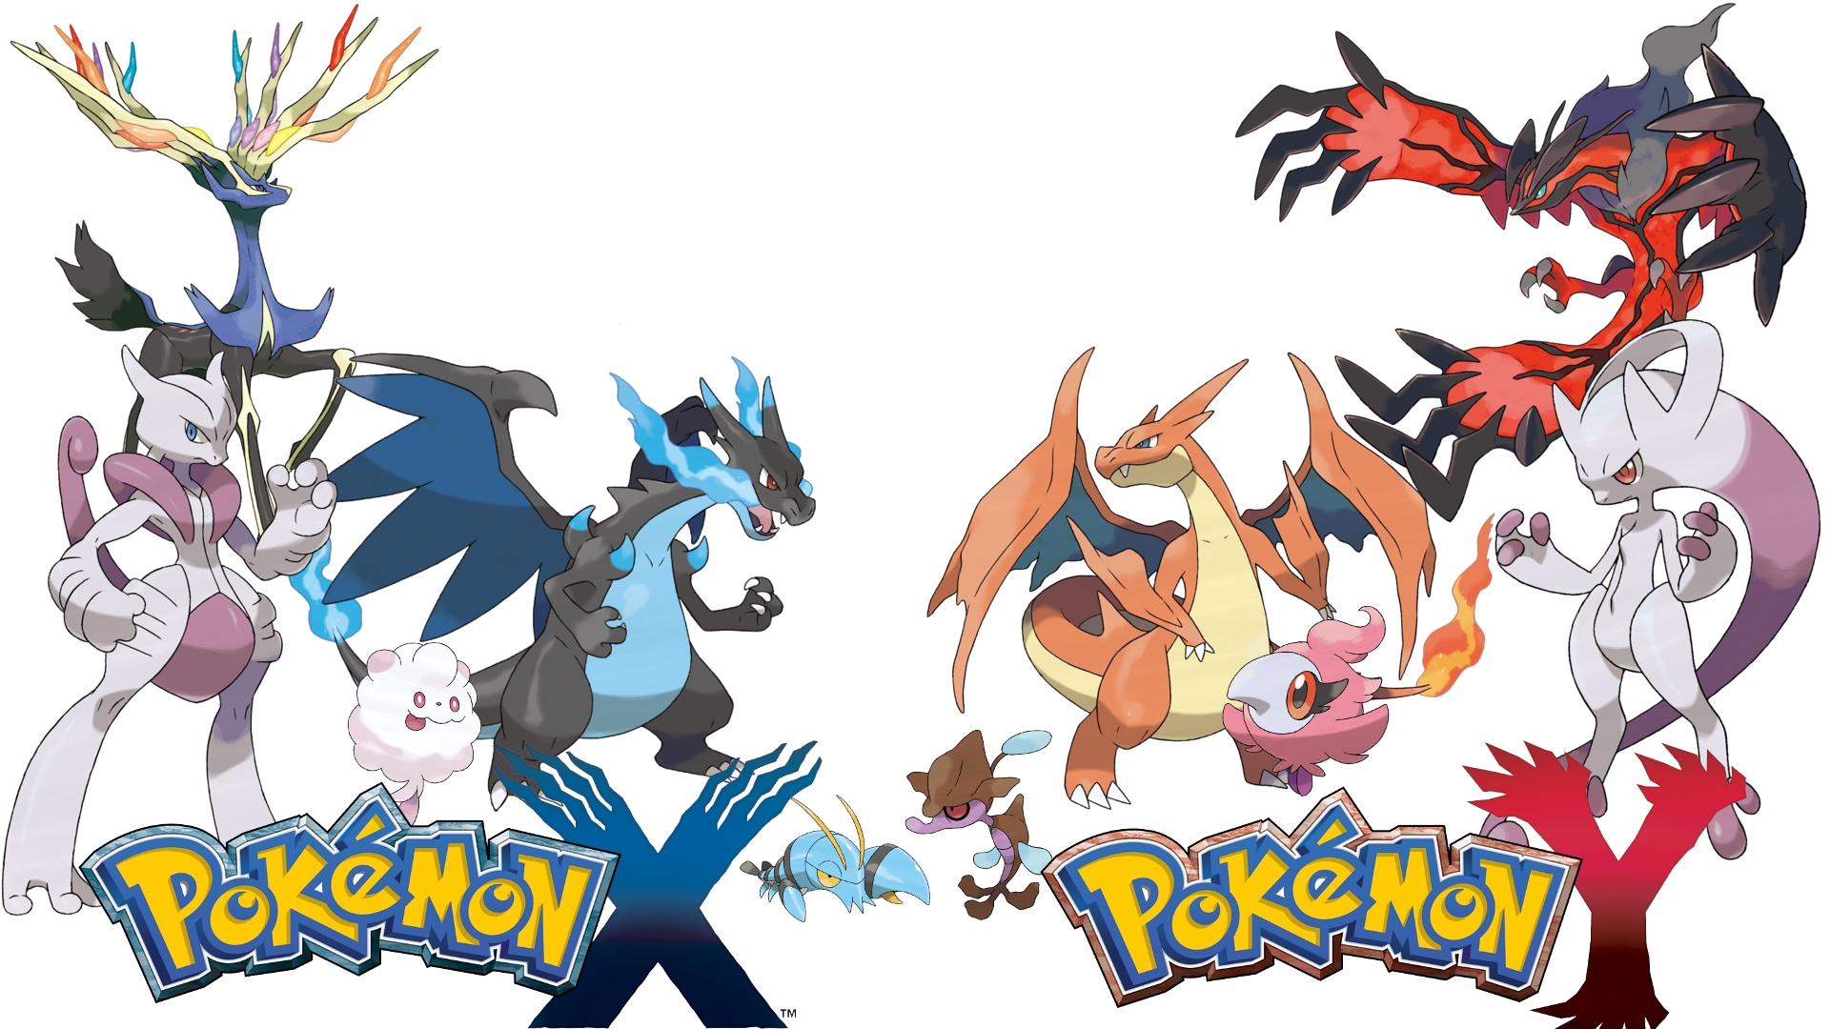
Modern Games
Name | Platform | Year of Release | Genre | Rating | Global Sales (in million)
Grand Theft Auto V | PS3 | 2013 | Action | M | 21.04
Grand Theft Auto V | X360 | 2013 | Action | M | 16.27
Call of Duty: Black Ops 3 | PS4 | 2015 | Shooter | M | 14.63
Pokémon X/Pokémon Y | 3DS | 2013 | Role-Playing | RP | 14.6
Call of Duty: Black Ops II | PS3 | 2012 | Shooter | M | 13.79
This is what we’ve observed from the rating trend: Game designed for adults make the most sales.
Notes:
These numbers and characters tells the story
make the most sales Which means unlocking the secret of success

Slide 14
Conclusion
Action and sports consistently dominate in Global sales. Develop action or sports games for North America, Europe, or other regions excluding Japan, because the role-playing genre dominates the Japanese market.
Over time, there has been a noticeable shift from “E” (everyone)to the trend towards designing games with “M” (Mature) rating. Concentrate on designing games for adults.
Despite having the lowest percentage, it’s noteworthy that action contributes the most global sales.
Long-lived platforms include GB, Xbox360, PS2 and PS3, Wii. The lifetime of the platform is around 9 years. The DS Platform game has remarkable 35-year lifetime.

Slide 15

Thank You

